Slide 1
OPER 618 Lesson 15 Coalition Games
Dr. Brian J. Lunday
Office: Rm 201E, Bldg 641

Slide 2
Motivating Coalition Games
What are some areas of application in which players cooperate but have to share the benefits (or costs)?
Diplomatic agreements (e.g., treaties, conventions, accords)
Information-sharing agreements (e.g., FVEY, tech. interchange)
Military/security agreements (e.g., NATO, Interpol)
Economic consortiums (e.g., G7, NAFTA)
Legal agreements (e.g., UNCLOS, ICC, Hague Conventions, NPT)
Gangs
Drug cartels
Terrorist organizations

Slide 3
Coalition Game Concerns
Who should be a member? Who should not?
Would anyone be better off not joining?
Would anyone (or any sub-group) be better off if they split off and formed their own, smaller group?
Is there a fair distribution of benefits (or costs)?

Slide 4
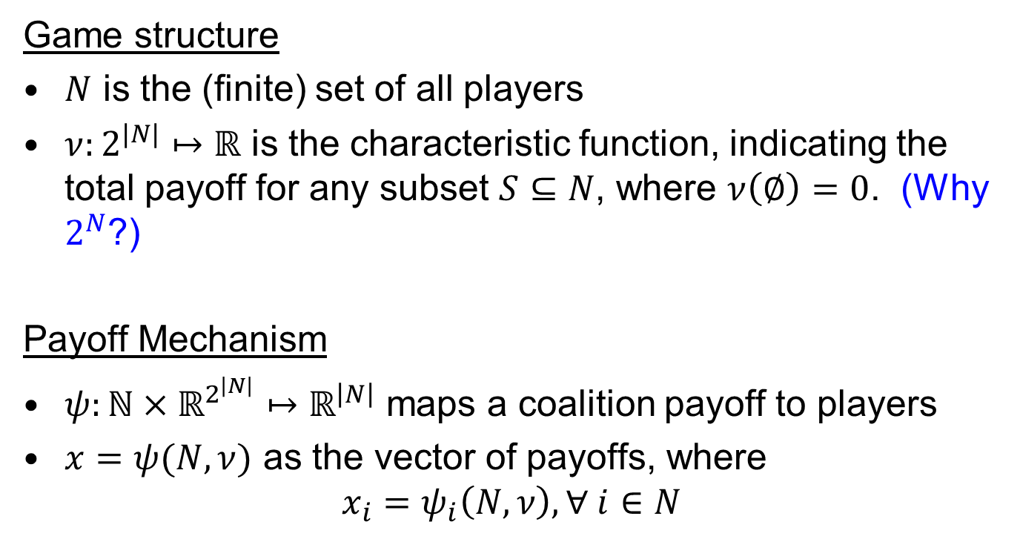
Coalition Games with TU
Game structure
$N$ is the (finite) set of all players
$ν:2^{|N|}↦ℝ$ is the characteristic function, indicating the total payoff for any subset $S⊆N$, where $ν\left(∅\right)=0$. (Why $2^{N}$?)
Payoff Mechanism
$ψ:ℕ×ℝ^{2^{\left|N\right|}}↦ℝ^{\left|N\right|}$ maps a coalition payoff to players
$x=ψ(N,ν)$ as the vector of payoffs, where
$$x_{i}=ψ_{i}\left(N,ν\right), ∀ i∈N$$

Slide 5

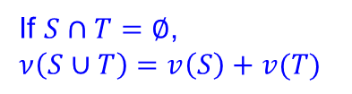
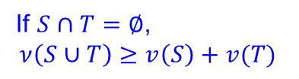



Game Classes and Relationships
Convex
Superadditive
$ν\left(S∪T\right)≥v\left(S\right)+v\left(T\right)−ν(S∩T)$
If $S∩T=∅$,
$ν\left(S∪T\right)≥v\left(S\right)+v(T)$
Additive
If $S∩T=∅$,
$ν\left(S∪T\right)=v\left(S\right)+v(T)$
Constant Sum
$ν\left(S\right)+ν\left(N\backslash S\right)=v\left(N\right)$
Proper simple
If $ν\left(S\right)=1, ν\left(N\backslash S\right)=0$
Simple
$ν\left(S\right)∈\left\{0,1\right\}$

Slide 6

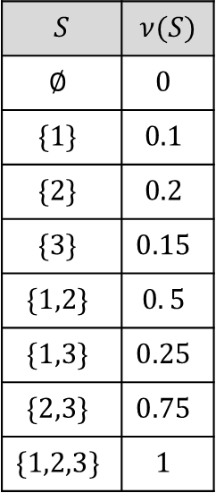
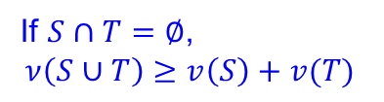
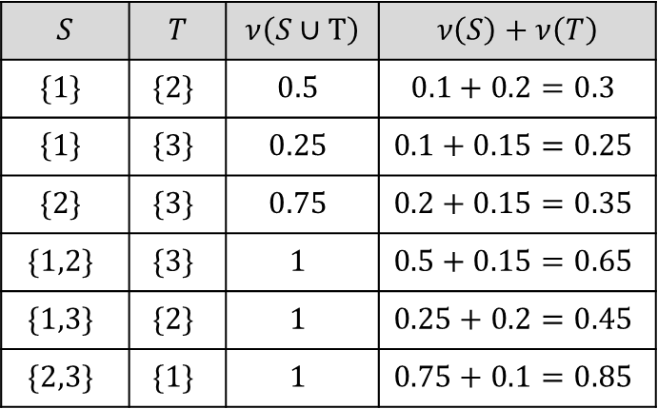
Coalition Game Example
$$N=\{1,2,3\}$$
Is this game superadditive?
$$S$$ | $$ν(S)$$
$$∅$$ | $$0$$
$$\{1\}$$ | $$0.1$$
$$\{2\}$$ | $$0.2$$
$$\{3\}$$ | $$0.15$$
$$\{1,2\}$$ | $$0. 5$$
$$\{1,3\}$$ | $$0.25$$
$$\{2,3\}$$ | $$0.75$$
$$\{1,2,3\}$$ | $$1$$
$$S$$ | $$T$$ | $$ν\left(S∪T\right)$$ | $$ν\left(S\right)+ν\left(T\right)$$
$$\{1\}$$ | $$\{2\}$$ | $$0.5$$ | $$0.1+0.2=0.3$$
$$\left\{1\right\}$$ | $$\left\{3\right\}$$ | $$0.25$$ | $$0.1+0.15=0.25$$
$$\{2\}$$ | $$\{3\}$$ | $$0.75$$ | $$0.2+0.15=0.35$$
$$\{1,2\}$$ | $$\{3\}$$ | $$1$$ | $$0.5+0.15=0.65$$
$$\{1,3\}$$ | $$\{2\}$$ | $$1$$ | $$0.25+0.2=0.45$$
$$\{2,3\}$$ | $$\{1\}$$ | $$1$$ | $$0.75+0.1=0.85$$
Superadditive
If $S∩T=∅$,
$ν\left(S∪T\right)≥v\left(S\right)+v(T)$

Slide 7

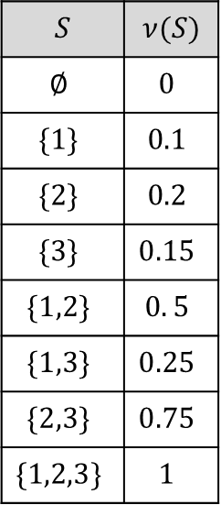

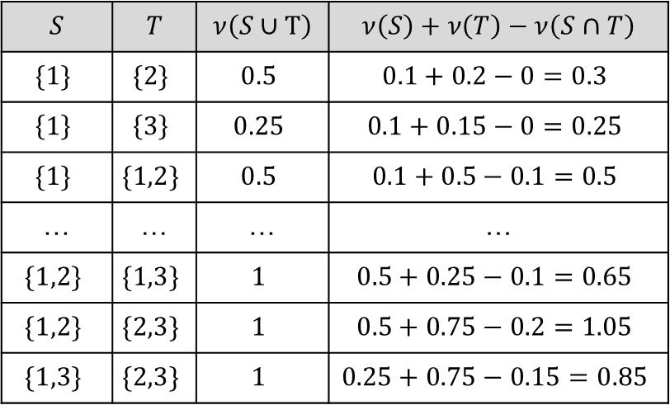
Coalition Game Example
$$N=\{1,2,3\}$$
Is this game convex?
$$S$$ | $$ν(S)$$
$$∅$$ | $$0$$
$$\{1\}$$ | $$0.1$$
$$\{2\}$$ | $$0.2$$
$$\{3\}$$ | $$0.15$$
$$\{1,2\}$$ | $$0. 5$$
$$\{1,3\}$$ | $$0.25$$
$$\{2,3\}$$ | $$0.75$$
$$\{1,2,3\}$$ | $$1$$
$$S$$ | $$T$$ | $$ν\left(S∪T\right)$$ | $$ν\left(S\right)+ν\left(T\right)−ν\left(S∩T\right)$$
$$\{1\}$$ | $$\{2\}$$ | $$0.5$$ | $$0.1+0.2−0=0.3$$
$$\left\{1\right\}$$ | $$\left\{3\right\}$$ | $$0.25$$ | $$0.1+0.15−0=0.25$$
$$\{1\}$$ | $$\{1,2\}$$ | $$0.5$$ | $$0.1+0.5−0.1=0.5$$
… | … | … | …
$$\{1,2\}$$ | $$\{1,3\}$$ | $$1$$ | $$0.5+0.25−0.1=0.65$$
$$\{1,2\}$$ | $$\{2,3\}$$ | $$1$$ | $$0.5+0.75−0.2=1.05$$
$$\{1,3\}$$ | $$\{2,3\}$$ | $$1$$ | $$0.25+0.75−0.15=0.85$$
Convex
$ν\left(S∪T\right)≥v\left(S\right)+v\left(T\right)−ν(S∩T)$

Slide 8
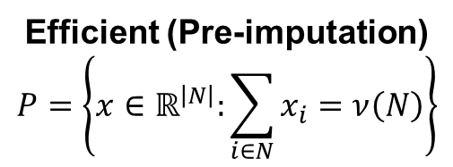
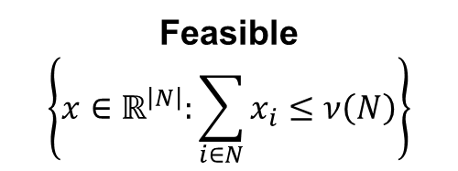

Payoff Characteristics
Do these characteristics provide incentive to join a coalition?
If so, how?
If not, what do they achieve?
Do they induce a fair division of the TU?
What is fair?
Feasible
$$\left\{x∈ℝ^{\left|N\right|}:\sum_{i∈N}{x_{i}}≤ν\left(N\right)\right\}$$
Efficient (Pre-imputation)
$$P=\left\{x∈ℝ^{\left|N\right|}:\sum_{i∈N}{x_{i}}=ν\left(N\right)\right\}$$
Individually Rational (Imputation)
$$\left\{x∈P:x_{i}≥ν\left(i\right), ∀i∈N\right\}$$

Slide 9





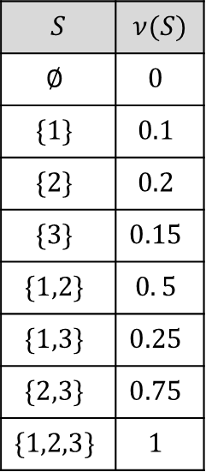




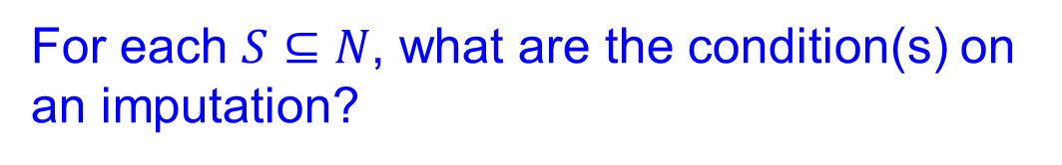

Coalition Game Example
For each $S⊆N$, what are the condition(s) on an imputation?
$$N=\{1,2,3\}$$
$$S$$ | $$ν(S)$$
$$∅$$ | $$0$$
$$\{1\}$$ | $$0.1$$
$$\{2\}$$ | $$0.2$$
$$\{3\}$$ | $$0.15$$
$$\{1,2\}$$ | $$0. 5$$
$$\{1,3\}$$ | $$0.25$$
$$\{2,3\}$$ | $$0.75$$
$$\{1,2,3\}$$ | $$1$$
$$x=(1,0,0)$$
$$x_{2}≥0. 2$$
$$x_{3}≥0. 15$$
$$x_{1}+x_{2}≥0. 5$$
$$x_{1}+x_{3}≥0. 25$$
$$x_{2}+x_{3}≥0. 75$$
$$x_{1}≥0. 1$$
$$(0,1,0)$$
$$(0,0,1)$$
What is the significance of the green triangle?
How about the red parallelogram?

Slide 10
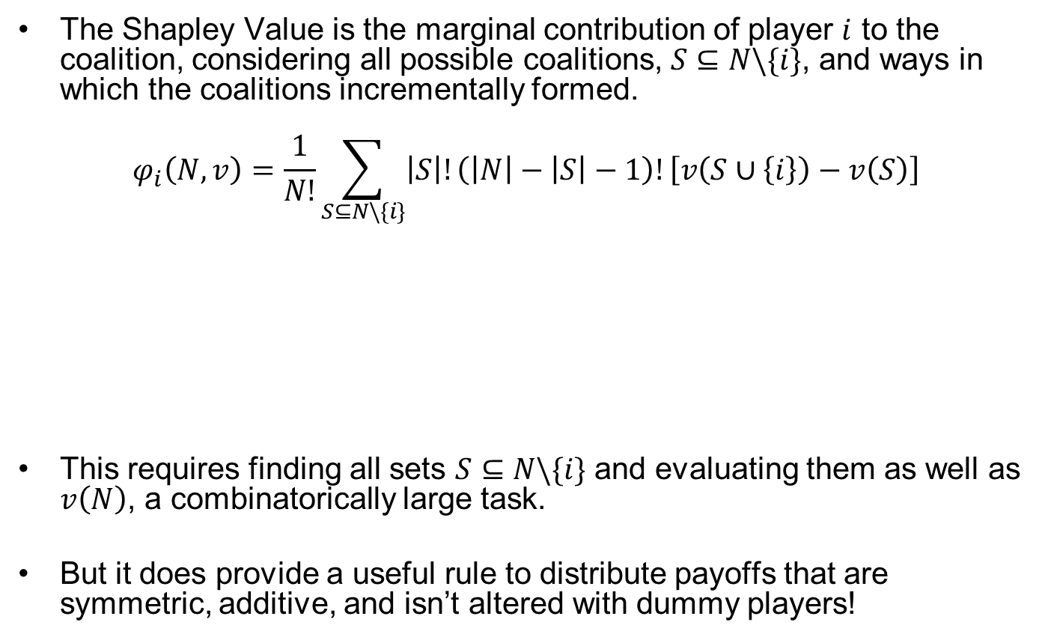
The Shapley Value A Canonical Characteristic Function
The Shapley Value is the marginal contribution of player $i$ to the coalition, considering all possible coalitions, $S⊆N\backslash \{i\}$, and ways in which the coalitions incrementally formed.
$$φ_{i}\left(N,v\right)=\frac{1}{N!}\sum_{S⊆N\backslash \{i\}}{\left|S\right|!\left(\left|N\right|−\left|S\right|−1\right)!\left[v\left(S∪\left\{i\right\}\right)−v\left(S\right)\right]}$$
This requires finding all sets $S⊆N\backslash \{i\}$ and evaluating them as well as $v\left(N\right)$, a combinatorically large task.
But it does provide a useful rule to distribute payoffs that are symmetric, additive, and isn’t altered with dummy players!
Assign a payoff to each player $i$ in a coalition $N$and for a coalition value function $v$
Average over the possible ordering of players
Over all sets S before $i$ joins
All the possible sequences of players joining Coalition S and its complement
How much Player $i$ contributes when he joints coalition $S$

Slide 11

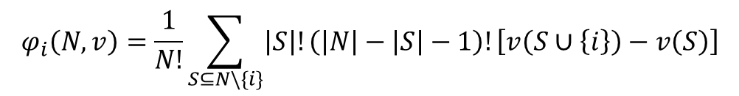

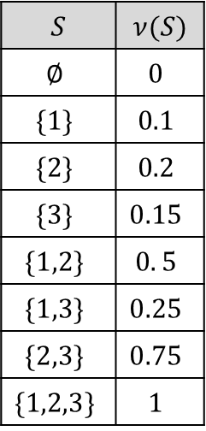

The Shapley Value Illustrative Example
$$φ_{i}\left(N,v\right)=\frac{1}{N!}\sum_{S⊆N\backslash \{i\}}{\left|S\right|!\left(\left|N\right|−\left|S\right|−1\right)!\left[v\left(S∪\left\{i\right\}\right)−v\left(S\right)\right]}$$
$$S$$ | $$ν(S)$$
$$∅$$ | $$0$$
$$\{1\}$$ | $$0.1$$
$$\{2\}$$ | $$0.2$$
$$\{3\}$$ | $$0.15$$
$$\{1,2\}$$ | $$0. 5$$
$$\{1,3\}$$ | $$0.25$$
$$\{2,3\}$$ | $$0.75$$
$$\{1,2,3\}$$ | $$1$$
$$φ_{1}\left(N,v\right)=\frac{1}{6}\left[2\left(0.1\right)+1\left(0.3\right)+1\left(0.1\right)+2(0.25)\right]=0.1833$$
1-2-3
1-3-2
2-1-3
3-1-2
2-3-1
3-2-1
$$φ_{2}\left(N,v\right)=\frac{1}{6}\left[2\left(0.2\right)+1\left(0.4\right)+1\left(0.6\right)+2(0.75)\right]=0.4833$$
2-1-3
2-3-1
1-2-3
3-2-1
1-3-2
3-1-2
$$x=(1,0,0)$$
$$φ_{3}\left(N,v\right)=\frac{1}{6}\left[2\left(0.15\right)+1\left(0.15\right)+1\left(0.55\right)+2(0.5)\right]=0.3333$$
3-1-2
3-2-1
1-3-2
2-3-1
1-2-3
2-1-3
$$(0,1,0)$$
$$(0,0,1)$$

Slide 12
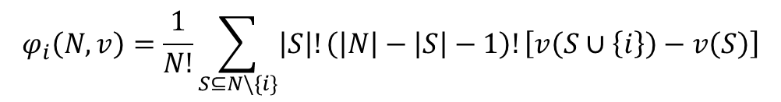


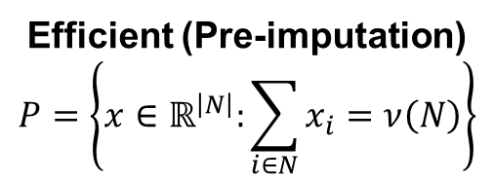
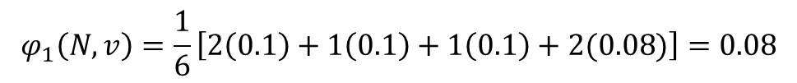
The Shapley Value A pre-imputation but not always an imputation
Efficient (Pre-imputation)
$$P=\left\{x∈ℝ^{\left|N\right|}:\sum_{i∈N}{x_{i}}=ν\left(N\right)\right\}$$
Individually Rational (Imputation)
$$\left\{x∈P:x_{i}≥ν\left(i\right), ∀i∈N\right\}$$
$$S$$ | $$ν(S)$$
$$∅$$ | $$0$$
$$\{1\}$$ | $$0.1$$
$$\{2\}$$ | $$0.2$$
$$\{3\}$$ | $$0.2$$
$$\{1,2\}$$ | $$0. 3$$
$$\{1,3\}$$ | $$0.3$$
$$\{2,3\}$$ | $$0.92$$
$$\{1,2,3\}$$ | $$1$$
$$φ_{i}\left(N,v\right)=\frac{1}{N!}\sum_{S⊆N\backslash \{i\}}{\left|S\right|!\left(\left|N\right|−\left|S\right|−1\right)!\left[v\left(S∪\left\{i\right\}\right)−v\left(S\right)\right]}$$
$$φ_{1}\left(N,v\right)=\frac{1}{6}\left[2\left(0.1\right)+1\left(0.1\right)+1\left(0.1\right)+2(0.08)\right]=0.08$$
1-2-3
1-3-2
2-1-3
3-1-2
2-3-1
3-2-1

Slide 13
Questions & Discussion

